Slide 1


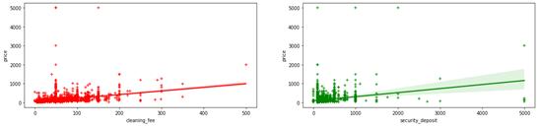
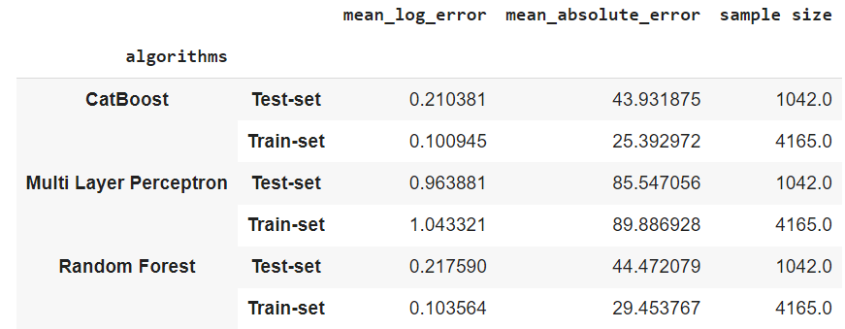
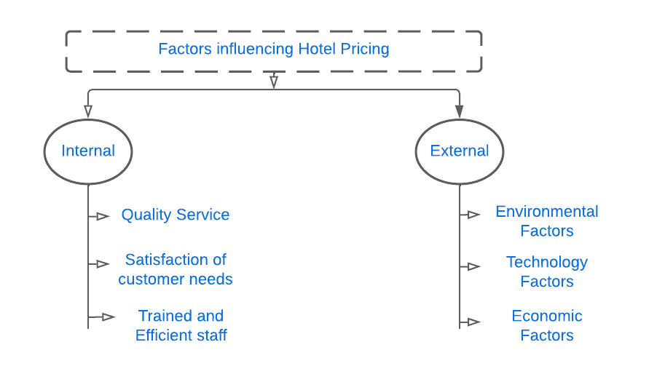
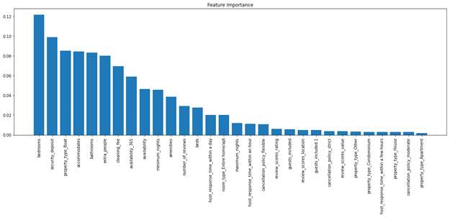
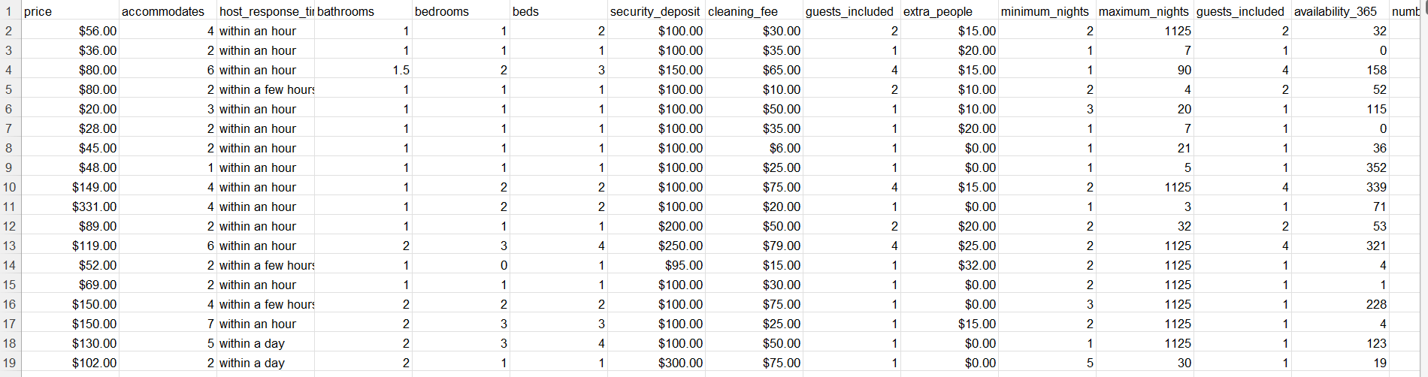
Optimal Hotel Pricing Using Machine Learning
Megha Shah (3156703)
Department of Computer and Information Science, Gannon University
GCIS 605: Scholarship Seminar
ABSTRACT
INTRODUCTION
RESULT
In this research paper, we present the analysis of dependency factors such as Price, Room Availability, and Client Feedback by offering an Optimal hotel pricing technique which especially focuses on revenue management systems to increase the revenue of the hotels and adjust the prices to meet demand.
The main objective is to create a system that would enable us to suggest dynamic hotel rates automatically based on current market information for upcoming check-ins.
The paper aims to work on the research gap between the traditional method of predicting prices & Modern Machine Learning algorithms to find better accuracy.
We have collected a dataset from San Francisco Downtown locations, and our targeted population is Hotels from San Francisco. We have taken a sample size of 5200 with 28 other attributes by doing Quantitative Analysis, including Random Forest Regression Technique, Multi-Layer Perceptron Regression Technique and Cat Boost Algorithm.
By doing the Analysis, we found that the hotel prices for the business stay are affected more by other metrics like the number of visitors & number of people accommodated in the room for the business stay by using Multi-Layer Perceptron Regression which is giving the best result when compared with other Algorithms.
By effectively implementing the suggested strategy to the hotel revenue management challenges, we have tested the technique. The provided models aid practitioners in improving revenue optimization and prediction accuracy, and they offer a starting point for further study into creating machine learning models for controlling hotel revenue.
Any type of organization must have a means of generating income. Of course, for your business to grow and succeed, you'll need to make enough money to cover your costs as well as some additional revenue. You will require a more advanced pricing strategy in the current competitive market, as well as the adaptability to make changes, as necessary. Price optimization and revenue management are the two most crucial concerns that every organization must address. Dynamic pricing enables a business to become more competitive and bounce back from poor decisions.
There are certain internal and external factors that influence hotel pricing. In this paper, we are concentrating on Internal Factors.
Chart 1. Factors influencing Hotel Pricing
The problem to be addressed by this study is the challenges that the hotels face using traditional methods over modern ML Techniques to increase their hotel revenue.
RQ 1: About the customer (P), how will the machine learning model prioritize hotel amenities (I) about other parameters (C) for optimal pricing to (O) retain the customer and make the hotel profitable(C)?
Chart 2. Based on Cleanliness Fee Chart 3.Based on Security Deposit.
Method 1: Random Forest Regression Technique
Employs an ensemble learning approach for regression and is a supervised learning algorithm. The ensemble learning method combines predictions from various machine learning algorithms to provide predictions that are more accurate than those from a single model to create and display the random forest models, we have used random Forest packages. Because there are too many outliers in this dataset, it is preferable to employ techniques that attempt to reduce impurity during fitting. Overfitting can be decreased through pruning. I used the hyperparameter tuning technique to determine the ideal random forest parameters before fitting the model. The best parameters of random forests are:
max depth – 11, Number of estimators – 120, Criterion – log
Chart 4. Descending order of Random Forest Regression Technique
Method 2: Multi-Layer Perceptron Regression
It is a neural network that inputs normalized data, performs some preliminary processing, and outputs the outcome. It's a type of "black box" model that doesn't need any manual engineering, unlike a random forest, however training these models to outperform conventional machine learning models requires more data. It is prone to anomalies. Using hyperparameter tuning we obtained the following optimal parameters:
Hidden layer size – 34, Solver – adam, Alpha - 0.0005, Activation – relu, Number of iterations – 7000
Method 3: Catboost
Catboost expands on gradient boosting and decision tree theory. The basic goal of boosting is to successively combine many weak models or models that just slightly outperform the chance, to produce a strong, competitive predictive model through greedy search. By training a series of weak learners, the boosting algorithm's main benefit is its ability to handle outliers. In contrast to previous methods, it also works well on samples outside of distribution. Using hyperparameter tuning we obtained the following optimal parameters:
Learning rate - 0.03, depth – 8, L2_ref_reg - 0.2, Number of iterations - 150
The same number of samples and data distribution was used for both model training and testing. With a mean absolute error of 25.39 on the train set and 43.93 on the test set, the Catboost approach performed better than the neural network and random forest model. Even while the Catboost performed well, unlike the MLP regressor, it is not extended to the test set, which causes overfitting. The MLP regressor will perform better if the dataset has more samples because neural networks are data-hungry.
DISCUSSION
We describe a dynamic pricing method for hotel revenue management in this research. The proposed dynamic pricing system is composed of three components. The initial step is to gather any hotel's historical data records. In the second section, numerous characteristics such as price, room availability, and customer reviews are analyzed in order to provide dynamic pricing. The final stage entails running a few regression algorithms on the supplied data to generate dynamic hotel pricing. We proposed a novel strategy that used regression algorithms. The Random Forest Regressor, Catboost and Multilayer Perceptron Regressor algorithms were used, and the results were recorded. The random forest strategy outperformed the neural network model. Even though the random forest outperformed the MLP regressor, it was not extended to the test set, resulting in overfitting. Because neural networks are data-hungry, the MLP regressor will perform better if the dataset contains more samples.
METHODS AND MATERIALS
The data we have collected for this paper is from hotels in San Francisco Downtown Locations which is also our targeted population. We have collected datasets from insideAirbnb website of San Francisco with a sample size of 5200 with 28 other attributes by using quantitative analysis, which includes Random Forest Regression Technique, Multi-Layer Perceptron Regression Technique and Catboost Algorithm.
REFERENCES
Ankit Raj, (2019) Hotel Dynamic Pricing, https://tech.goibibo.com/hotel-dynamic-pricing-7042a561f8a3
Abdel Aziz, H., Saleh, M., Rasmy, M. and El-Shishiny, H. (2011) Dynamic room pricing model for hotel revenue management systems. Egyptian Informatics Journal. 12(3):177-183.
ACKNOWLEDGMENT
“We would like to express our sincere gratitude to my Professor Dr Joshua C. Nwokeji for his patient guidance, invaluable acknowledgement of my team members for being good team players and backing up goals with encouragement, and helpful critique throughout our research. Finally, I want to actions”.

